Slide 1
What’s Cooking? – A Recipe Cuisine-Type Classification Problem
Huaxin Pang
Zayd Hammoudeh

Slide 2
Dataset and Project Overview
Yummly.com – A food and cooking centric social media platform. [1]
In September 2015, Yummly posted a dataset on Kaggle consisting of a set of recipes and ingredients [2].
Project Goal: Develop a classifier that can correctly categorize recipes into a single cuisine type (e.g. Indian, Chinese, etc.) using only a list of ingredients.
[1] “Introducing the Ultimate Cooking Tool,” Yummly. [Online]. Available at: http://www.yummly.com/how-it-works/. [Accessed: Oct-2015].
[2] “What's Cooking?,”. [Online]. Available at: https://www.kaggle.com/c/whats-cooking. [Accessed: Oct-2015].

Slide 3
Dataset Record Format
Record Format: JSON. The primary record contents are:
Cuisine type class label
List of ingredients
{
"id": 24717,
"cuisine": "indian",
"ingredients": [
"tumeric",
"vegetable stock",
"tomatoes",
"garam masala",
"naan",
"red lentils",
"red chili peppers",
"onions",
"spinach",
"sweet potatoes"
]
}
Example Record for a Recipe of Cuisine Type “Indian” [1]
[1] “What's Cooking?,”. [Online]. Available at: https://www.kaggle.com/c/whats-cooking. [Accessed: Oct-2015].
Notes:
Mention here this will become important later.

Slide 4
Training Dataset Statistics
Number of Recipes: 39,774
Number of Unique Ingredients: 6,714
Number of International Cuisine Types: 20
Notes:
All Italian Benchmark – 19.7%
20 Different Cuisine Types (See the bottom axis)

Slide 5
Overview of the
Classification Strategies

Slide 6
Importance of Data Preprocessing and Representation
Data Representation – Too commonly overlooked but is often the most critical step for classification.
Prism through which you look at the data.
Different approaches may reveal different trends.
Our three data representation schemes for this dataset:
Ingredient Sets
“Vectorized” Ingredients List
Bag of Words

Slide 7
Note: Due to limited time in class, we will present only a subset of our slides.
We have provided the full set of slides to Dr. Moh to help you prepare for the final exam.

Slide 8
Approach #1 – Ingredient Sets

Slide 9
Dataset Record Format Review
Cuisine type class label
List of ingredients
{
"id": 24717,
"cuisine": "indian",
"ingredients": [
"tumeric",
"vegetable stock",
"tomatoes",
"garam masala",
"naan",
"red lentils",
"red chili peppers",
"onions",
"spinach",
"sweet potatoes"
]
}
Example Record for a Recipe of Cuisine Type “Indian” [1]
[1] “What's Cooking?,”. [Online]. Available at: https://www.kaggle.com/c/whats-cooking. [Accessed: Oct-2015].
Notes:
Just a quick review

Slide 10
“Ingredient Set” Data Representation
Each recipe has only one attribute.
Attribute Structure: Unordered set of the recipe’s ingredients
Example: If a recipe contains “flour”, “salt”, “unsalted butter”, “milk”, “baking powder”, and “sugar”, its attribute would be:
{salt, flour, baking powder, sugar, milk, unsalted butter}
Preprocessor Requirements: Since this approach is focused on exact matches of all of the ingredient text, the entire ingredient text needs to be cleaned.
Given the attribute’s relatively unordered structure, this approach is best suited for K-Nearest Neighbors.

Slide 11
Ingredient Name Preprocessing
The dataset’s recipe ingredient lists were human generated, which leads to variation in the ingredient names.
Example: “Garlic” and “cilantro” are represented by five different names based on the ingredient’s preparation and freshness.
Synonym Recognition – Field in natural language processing (NLP) where synonyms are recognized and normalized [1].
Simple Solution: Remove words from ingredient descriptions that are a distinction without a difference.
Example: Size (“small”, “medium”, “large”) and preparation (“chopped”, “sliced”) descriptors.
Possible Danger: Words in natural language are ambiguous. Hence, blindly removing a without context can remove key, differentiating descriptors.
Example: If the word “hot” were filtered, “hot water” would become “water”, but “hot sauce” becomes just “sauce”, which is too vague.
[1] S. J. Russell and P. Norvig, Artificial intelligence: a modern approach, 3rd ed. Chapter 23. Upper Saddle River, NJ: Prentice Hall, 2010.

Slide 12
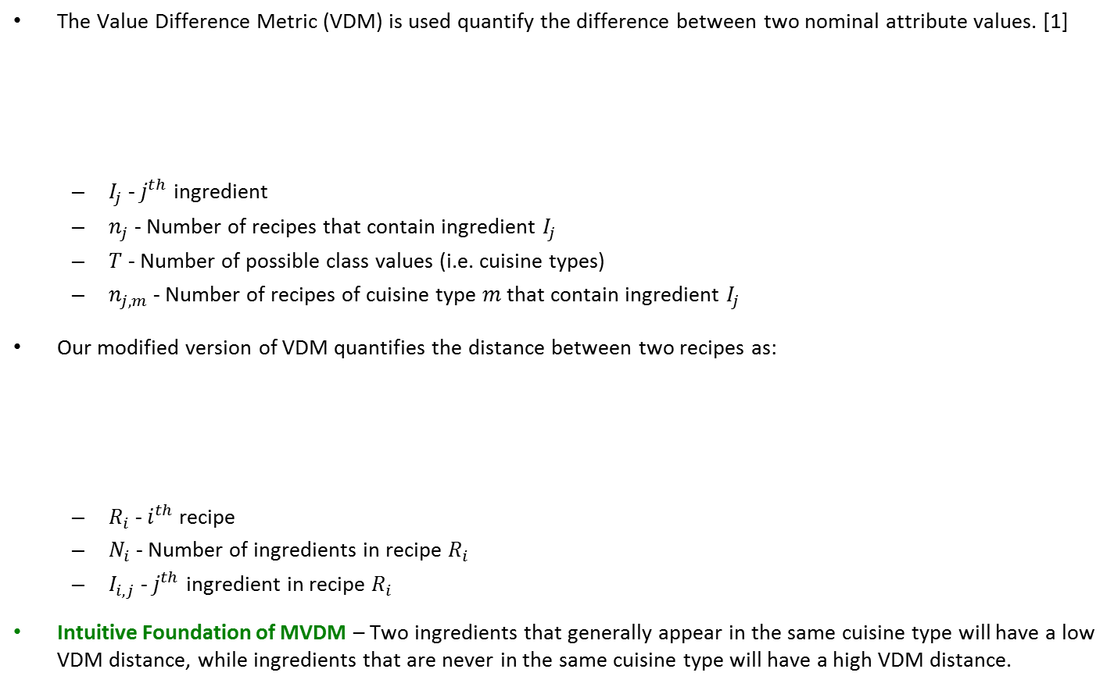
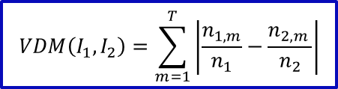
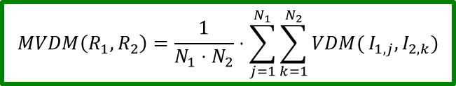
Modified Value Difference Metric (MVDM)
The Value Difference Metric (VDM) is used quantify the difference between two nominal attribute values. [1]
$I_{j}$ - $j^{th}$ ingredient
$n_{j}$ - Number of recipes that contain ingredient $I_{j}$
$T$ - Number of possible class values (i.e. cuisine types)
$n_{j,m}$ - Number of recipes of cuisine type $m$ that contain ingredient $I_{j}$
Our modified version of VDM quantifies the distance between two recipes as:
$R_{i}$ - $i^{th}$ recipe
$N_{i}$ - Number of ingredients in recipe $R_{i}$
$I_{i,j}$ - $j^{th}$ ingredient in recipe $R_{i}$
Intuitive Foundation of MVDM – Two ingredients that generally appear in the same cuisine type will have a low VDM distance, while ingredients that are never in the same cuisine type will have a high VDM distance.
$$VDM\left(I_{1},I_{2}\right)=\sum_{m=1}^{T}{\left|\frac{n_{1,m}}{n_{1}}−\frac{n_{2,m }}{n_{2}}\right|}$$
$$MVDM\left(R_{1},R_{2}\right)=\frac{1}{N_{1}⋅N_{2}}⋅\sum_{j=1}^{N_{1}}{\sum_{k=1}^{N_{2}}{VDM(}I_{1,j},I_{2,k})}$$
[1] Improved Heterogeneous Distance Functions Journal of Artificial Intelligence Research, Vol. 6 (January 1997), pp. 1-34 by Randall Wilson, Tony R. Martinez

Slide 13
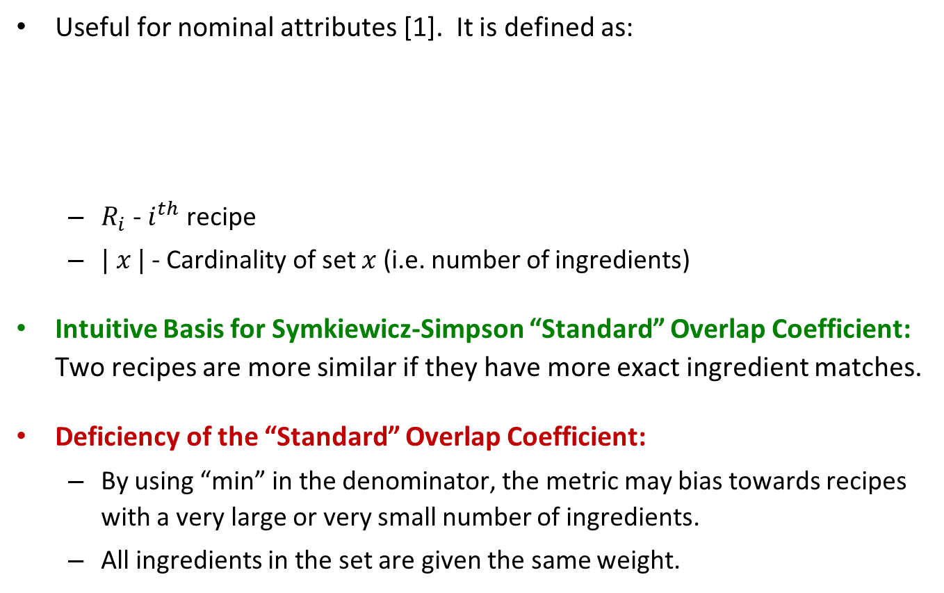
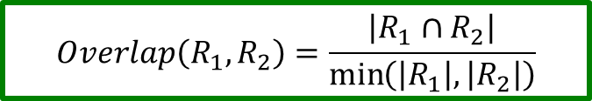
Szymkiewicz-Simpson Overlap Coefficient
Useful for nominal attributes [1]. It is defined as:
$R_{i}$ - $i^{th}$ recipe
$| x |$ - Cardinality of set $x$ (i.e. number of ingredients)
Intuitive Basis for Symkiewicz-Simpson “Standard” Overlap Coefficient: Two recipes are more similar if they have more exact ingredient matches.
Deficiency of the “Standard” Overlap Coefficient:
By using “min” in the denominator, the metric may bias towards recipes with a very large or very small number of ingredients.
All ingredients in the set are given the same weight.
[2]
$$Overlap\left(R_{1},R_{2}\right)=\frac{\left|R_{1}∩R_{2}\right|}{\min\left(\left|R_{1}\right|,\left|R_{2}\right|\right)}$$
[1] Baev, P. (1995). BIODIV: Program for calculating biological diversity parameters, similarity, niche overlap, and cluster analysis : Version 5.1(2nd ed.). Sofia: Pensoft.
[2] “Overlap Coefficient,” Wikipedia. [Online]. Available at: https://en.wikipedia.org/wiki/overlap_coefficient. [Accessed: Nov-2015].
Notes:
We have four KNN distance metrics but we will only discuss two in these slides.

Slide 14
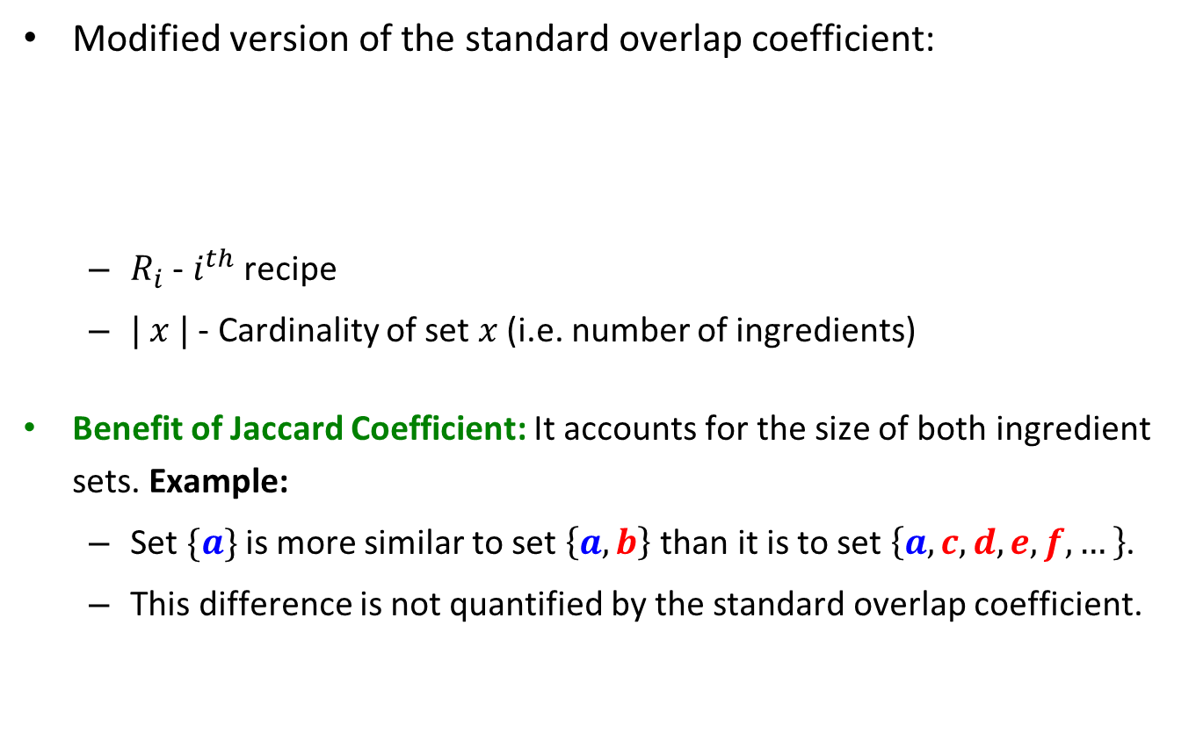
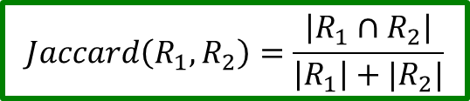
Jaccard Overlap Coefficient
Modified version of the standard overlap coefficient:
$R_{i}$ - $i^{th}$ recipe
$| x |$ - Cardinality of set $x$ (i.e. number of ingredients)
Benefit of Jaccard Coefficient: It accounts for the size of both ingredient sets. Example:
Set $\{a\}$ is more similar to set $\left\{a,b\right\}$ than it is to set $\left\{a, c,d,e,f,…\right\}$.
This difference is not quantified by the standard overlap coefficient.
[1]
$$Jaccard\left(R_{1},R_{2}\right)=\frac{\left|R_{1}∩R_{2}\right|}{\left|R_{1}\right|+|R_{2}|}$$
[1] “Jaccard index,” Wikipedia. [Online]. Available at: https://en.wikipedia.org/wiki/jaccard_index. [Accessed: Nov-2015].

Slide 15
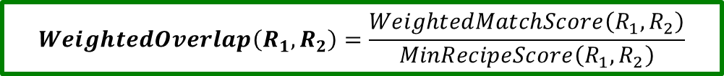
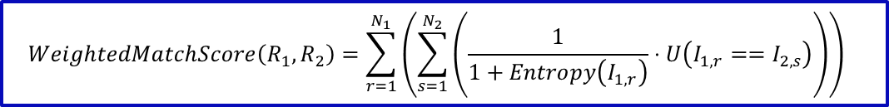
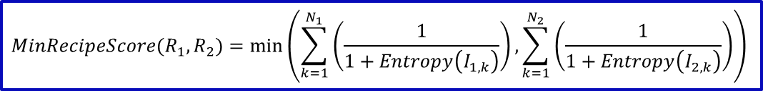
Entropy-Weighted Overlap Coefficient
A new metric we developed to address the deficiency that all ingredients in overlap coefficient are given the same weight. Solution: Weight by ingredient entropy.
R_{j} : j ^{th} Recipe
N_{j} : Number of ingredients in the j ^{th} recipe.
I_{j,k} : k ^{th} ingredient in recipe R_{j}
Entropy( I_{j,k} ) : Calculated entropy for ingredient I_{j,k}
U( p ) : Utility/indicator function. Equal to 1 if p is true; otherwise, it is equal to 0.
$$WeightedMatchScore\left(R_{1},R_{2}\right)=\sum_{r=1}^{N_{1}}{\left(\sum_{s=1}^{N_{2}}{\left(\frac{1}{1+Entropy\left(I_{1,r}\right)}⋅U\left(I_{1,r}==I_{2,s}\right)\right)}\right)}$$
$$MinRecipeScore(R_{1},R_{2})=\min\left(\sum_{k=1}^{N_{1}}{\left(\frac{1}{1+Entropy\left(I_{1,k}\right)}\right)},\sum_{k=1}^{N_{2}}{\left(\frac{1}{1+Entropy\left(I_{2,k}\right)}\right)}\right)$$
$$WeightedOverlap\left(R_{1},R_{2}\right)=\frac{WeightedMatchScore\left(R_{1},R_{2}\right)}{MinRecipeScore\left(R_{1},R_{2}\right)}$$
Notes:
Specifically mention that we came up with it and could not find it anywhere else in the literature.
High Level explanation only.

Slide 16
Distance Metric Performance Evaluation

Slide 17
Selecting the Value of “K”
The previous graph also allows us to compare the performance of different values of “K”.
For the weighted, inverse Jaccard, and standard overlap coefficients, the average accuracy was highest when K=8, K=16, and K=32 respectively.

Slide 18
Does using distance weighting improve our KNN performance?
No. There is no statistically significant change in accuracy. It may even be worse.
Reason: For our dataset, there was not a large difference in the distance for the top K neighbors negating the effect of this technique.
Solution: Do not use distance weighting per Occam’s Razor.

Slide 19
Approach #1 – Results and Advantages and Disadvantages
Advantages:
Decent Accuracy: 74%
Well suited for K-Nearest Neighbors (KNN)
Simple architecture design with extensibility through different distance metrics
Disadvantages:
Poor Time Performance due to KNN: O (N ) (where N is the number of training records)
Limited overall flexibility (only supports KNN well)

Slide 20
Approach #2 – “Vectorized”
Ingredient List

Slide 21
“Vectorized” Ingredients List Data Representation
Dataset Record Format: A list of ingredients in a recipe.
Total Number of Ingredients in the Entire Dataset: N
“Vectorized” Ingredients List Representation
Transform the ingredients list into an N -dimensional vector
Each element in the vector is a binary attribute representing whether a particular ingredient is present in the recipe.
This approach standardizes a record, which enables the use of most classification algorithms.

Slide 22
Classification Algorithms Used
Stochastic Gradient Descent K-Nearest Neighbors Ensemble Methods Bagging Adaboost Random Forest | Naïve Bayes Multinomial Naïve Bayes Bernoulli Naïve Bayes Decision Tree Support Vector Machine

Slide 23
Approach #2 - Algorithm Results Comparison
Algorithm Name | Best Accuracy
Stochastic Gradient Descent (SGD) | 76.83%
Bagging Classifier (Using SGD) | 75.43%
Naïve Bayes (Multinomial) | 75.16%
Naïve Bayes (Bernoulli) | 74.70%
Random Forests | 71.62%
AdaBoost (Using Decision Tree) | 68.30%
Decision Tree | 60.96%
K-Nearest Neighbor | 57.74%
Adaboost Classifier (Using SGD) | 47.96%

Slide 24
Approach #2 - Algorithm Results Comparison
Algorithm Name | Best Accuracy
Stochastic Gradient Descent (SGD) | 76.83%
Bagging Classifier (Using SGD) | 75.43%
Naïve Bayes (Multinomial) | 75.16%
Naïve Bayes (Bernoulli) | 74.70%
Random Forests | 71.62%
AdaBoost (Using Decision Tree) | 68.30%
Decision Tree | 60.96%
K-Nearest Neighbor | 57.74%
Adaboost Classifier (Using SGD) | 47.96%
We will discuss only the two best performing algorithm types

Slide 25
Stochastic/Incremental Gradient Descent
Based off linear classifiers similar to Support Vector Machine.
Stochastic gradient descent finds the classifier’s linear weights.
Multi-class Classification: Relies on a set of binary classifiers to distinguish different class values.
Each binary classifier uses a “One Versus All” (OVA) scheme where the classifier differentiates between one class and all other K – 1 classes.
Results in K unique classifiers.
Select the classifier result with the greatest “confidence score”/margin.
Maximum Accuracy: 76.83%
[1] “1.5. Stochastic Gradient Descent,” scikit-learn 0.17 documentation. [Online]. Available at: http://scikit-learn.org/stable/modules/sgd.html. [Accessed: Nov-2015].
[2] A. Ng, “CS229 Lecture Notes #1,” CS229 Machine Learning. [Online]. Available at: http://cs229.stanford.edu/notes/cs229-notes1.pdf. [Accessed: 2015].
Notes:
In both stochastic and “batch” gradient descent, a set of parameters (e.g. linear weights) are iteratively updated.
In “batch” gradient descent (GD), the parameters are updated once after iterating through all training set samples.
In stochastic gradient descent (SGD), the parameters are updated after each training set sample. SGD may converge faster than GD, but may not be as well optimized as GD.
SGD relies on some of the techniques of Stochastic Optimization and the incremental updates are based off the next selected point.

Slide 26
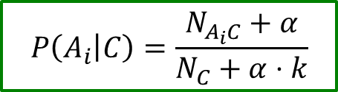
Naïve Bayes Comparison
Attribute conditional probability function we used:
A_{i} : Attribute value
C : Class Value
N_{C} : Number of records with class value C
N_{A,C} : Number of records of class value C with attribute value
k : Number of class values (e.g. 20)
α : Smoothing factor (if α = 1, then simply the Laplace metric)
Multinomial Naïve Bayes: Approach learned in class.
Bernoulli Naïve Bayes: Requires all attributes be binary and penalizes for the non-occurrence of a given attribute value (e.g. x’ ).
[1]
$$P\left(A_{i} | C\right)=\frac{N_{A_{i}C}+α}{N_{C}+α⋅k}$$
[1]
[1] “1.9. Naive Bayes,” scikit-learn 0.17 documentation. [Online]. Available at: http://scikit-learn.org/stable/modules/naive_bayes.html. [Accessed: Nov-2015].

Slide 27
Both approaches above used class prior probability [1] as that
provided better results for this dataset.
[1] “sklearn.naive_bayes.MultinomialNB,” scikit-learn 0.17 documentation. [Online]. Available at: http://scikit-learn.org/stable/modules/generated/sklearn.naive_bayes.multinomialnb.html. [Accessed: Nov-2015].

Slide 28
Approach #3 – Bag of Words

Slide 29
Ingredient Distribution by Word Count

Slide 30
Bag of Words Data Representation
Over 80% of ingredients are longer than one word.
Many words in the ingredient descriptions cause a “distinction without a difference”.
Example: “Taco Bell Taco Seasoning” vs. “Taco Seasoning”
Dividing ingredient lists into bags of words can help address that problem. Example:
“Taco Bell Taco Seasoning” → { “Taco”, “Bell” “Seasoning” }
“Taco Seasoning” → { “Taco”, “Seasoning” }
Two out of three words match versus no match using the full ingredient string (i.e. approach #2).

Slide 31
Converting an Ingredient List to Text
JSON Ingredient List
"ingredients": [
"romaine lettuce",
"black olives",
"grape tomatoes",
"garlic",
"pepper",
"purple onion",
"seasoning",
"garbanzo beans",
"feta cheese crumbles"
]
“Bag of Words” Text
romaine lettuce black olives grape tomatoes garlic pepper purple onion seasoning garbanzo beans feta cheese crumble

Slide 32
Techniques for Text/Word Preprocessing
Tokenization – Divide a series of characters into word “tokens” and discard any unimportant or unwanted characters (e.g. punctuation) [1].
Lemmatization – Extract the “lemma” (i.e. base or dictionary) form of a word [2].
Examples: “caresses” to “caress” and “dogs” to “dog”
Removing “Stop Words” – Delete common words (e.g. “the”, “a” “in”) that are of little value in text analysis [3].
Term Frequency-Inverse Document Frequency (TF-IDF) – Assigns a weight to a term based off its overall frequency (and in turn importance) in a document [4].
[1] “Tokenization,” The Stanford NLP (Natural Language Processing) Group. [Online]. Available at: http://nlp.stanford.edu/ir-book/html/htmledition/tokenization-1.html. [Accessed: Nov-2015].
[2] “Stemming and lemmatization,” The Stanford NLP (Natural Language Processing) Group. [Online]. Available at: http://nlp.stanford.edu/ir-book/html/htmledition/stemming-and-lemmatization-1.html. [Accessed: Nov-2015].
[3] “Dropping common terms: stop words,” The Stanford NLP (Natural Language Processing) Group. [Online]. Available at: http://nlp.stanford.edu/ir-book/html/htmledition/dropping-common-terms-stop-words-1.html. [Accessed: Nov-2015].
[4] “Tf-idf weighting,” The Stanford NLP (Natural Language Processing) Group. [Online]. Available at: http://nlp.stanford.edu/ir-book/html/htmledition/tf-idf-weighting-1.html. [Accessed: Nov-2015].

Slide 33
Approach #3 – Classification Algorithms Used
Stochastic Gradient Descent Perceptron Logistic Regression | Naïve Bayes Multinomial Naïve Bayes Bernoulli Naïve Bayes Random Forest Decision Tree

Slide 34
Approach #3 – Algorithm Results Comparison
Algorithm Name | Best Accuracy (Grid Search)
Stochastic Gradient Descent (SGD) | 76.2%
Logistic Regression | 75.9%
Random Forests | 75.2%
Perceptron | 72.8%
Naïve Bayes (Multinomial) | 72.2%
Naïve Bayes (Bernoulli) | 71.6%
Decision Tree | 63.0%

Slide 35
Algorithm and Parameter Searches
Algorithm search is as important as parameter search
Data distribution determines how algorithm performs
Due to the high number of dimensions, we did not know the data distribution.
Always perform grid search with cross validation as it prevents:
Leaking information from the test data
Overfitting to test data

Slide 36
Approach #3 – Results and Advantages and Disadvantages
Advantages:
Good Accuracy: 76.2%
Can extract more information in the ingredient names
Disadvantages:
Does not utilize the provided n-gram tokenization

Slide 37
Approach #4 – Stacked Generalization

Slide 38
Voting Schemes
There are two voting schemes ensemble classifiers typically use [1]:
Hard Voting – “Winner takes all”
“One algorithm, one vote”
Soft Voting – “Proportional representation”
Number of votes is relative to the class value’s probability
[1] “1.11. Ensemble methods,” scikit-learn 0.17 documentation. [Online]. Available at: http://scikit-learn.org/stable/modules/ensemble.html. [Accessed: Nov-2015].

Slide 39
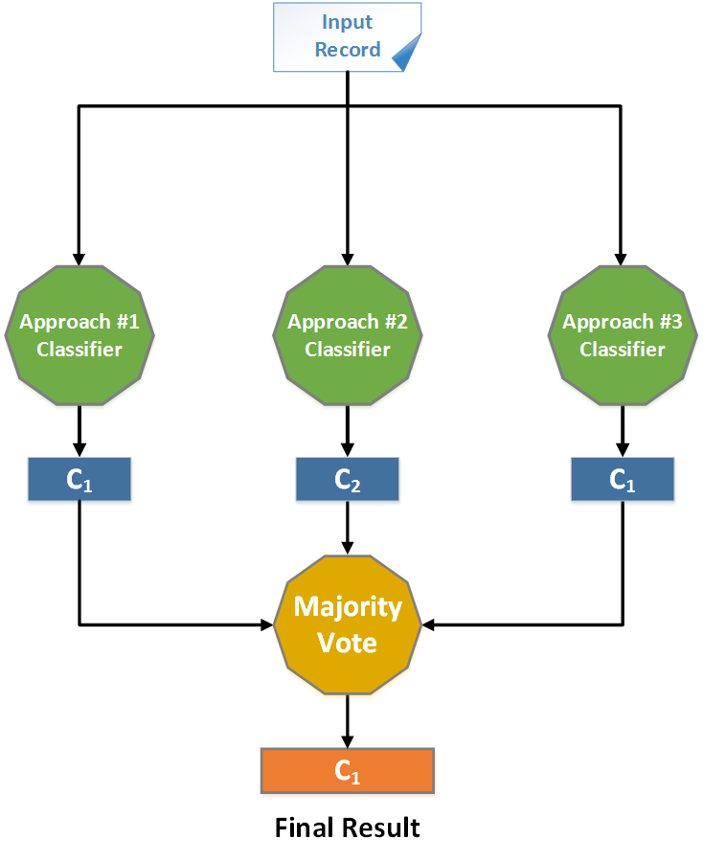
Hard Voting

Slide 40
Hard Voting (Continued)
Result: Accuracy increased to 77.9% (400th)
Deficiency: Each classifier only returns a single result and provide no data about the “non-selected” class types.
 | Approach #1 | Approach #2 | Approach #3
C₁ | 51% | 0 | 0
C₂ | 0 | 51% | 0
C₃ | 0 | 0 | 51%
C₄ | 49% | 49% | 49%
Example: The Limitation of Hard Voting

Slide 41
Soft Voting
Record
Approach #1
Approach #2
Approach #3
P(C₁) | P(C₂) | … | P(C_{N})
P(C₁) | P(C₂) | … | P(C_{N})
P(C₁) | P(C₂) | … | P(C_{N})
Σ P(C₁) | Σ P(C₂) | … | Σ P(C_{N})
C₁

Slide 42
Soft Voting (Continued)
Results: Accuracy increased again to 78.7% (270th)
Deficiencies:
Different algorithm has different measure for probability
Simple summation is not accurate
Can use a weighted sum, but we need a way to determine the weights.

Slide 43
Nature of Soft Voting
Record
Approach #1
Approach #2
Approach #3
P(C₁) | P(C₂) | … | P(C_{N})
P(C₁) | P(C₂) | … | P(C_{N})
P(C₁) | P(C₂) | … | P(C_{N})
Σ P(C₁) | Σ P(C₂) | … | Σ P(C_{N})
C₁

Slide 44
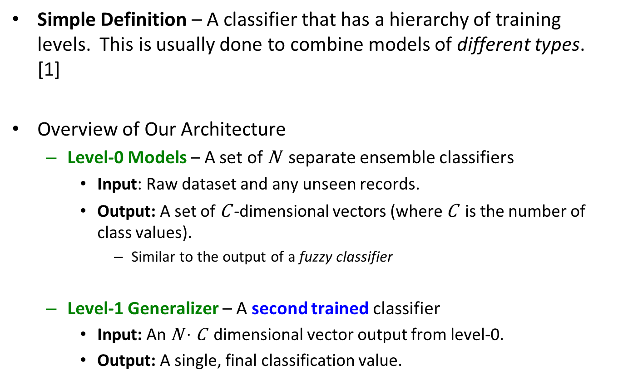
What is Stacked Generalization?
Simple Definition – A classifier that has a hierarchy of training levels. This is usually done to combine models of different types. [1]
Overview of Our Architecture
Level-0 Models – A set of N separate ensemble classifiers
Input: Raw dataset and any unseen records.
Output: A set of C -dimensional vectors (where C is the number of class values).
Similar to the output of a fuzzy classifier
Level-1 Generalizer – A second trained classifier
Input: An N $⋅$ C dimensional vector output from level-0.
Output: A single, final classification value.
[1] Ting, K.M. & Witten, I.H. (1997). Stacked generalization: when does it work? Hamilton, New Zealand: University of Waikato, Department of Computer Science.

Slide 45
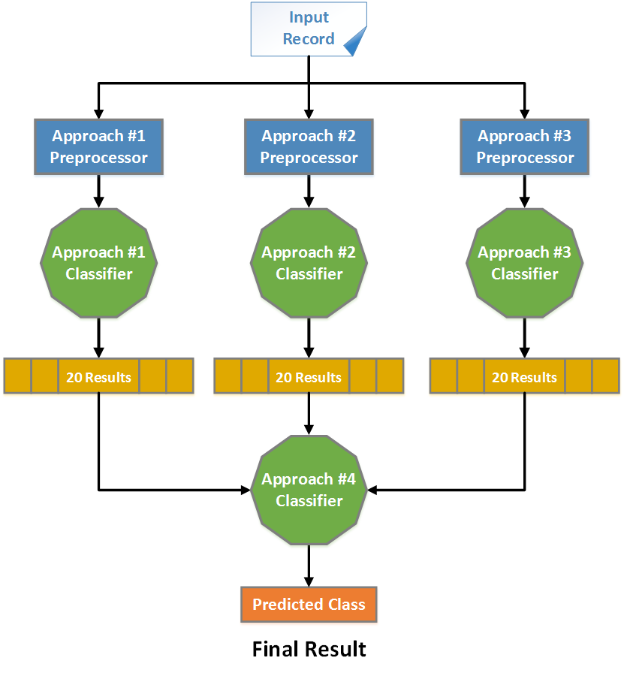
Simplified Stacked Generalization Model

Slide 46
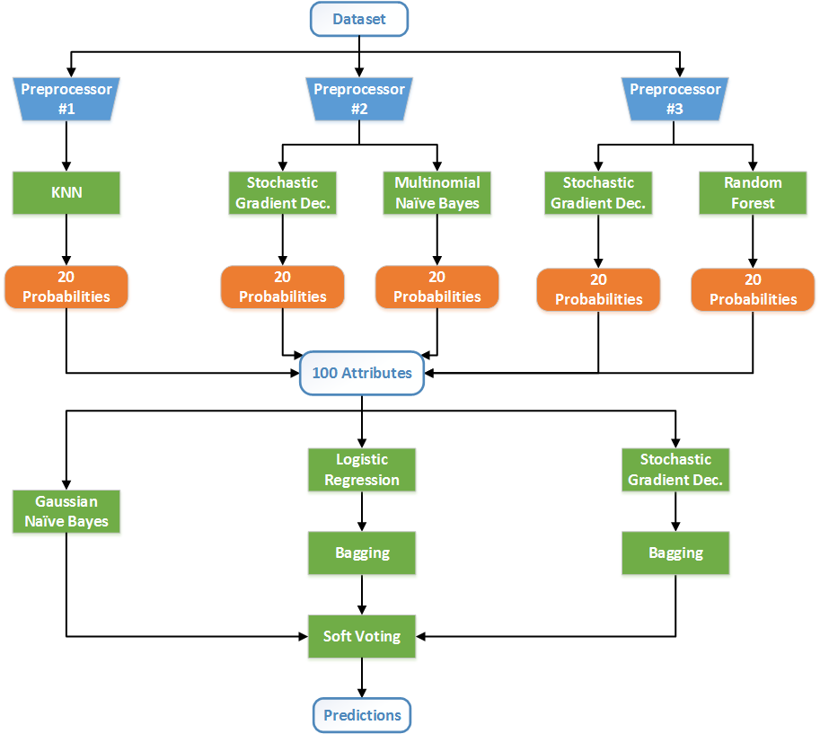
The Whole Picture

Slide 47
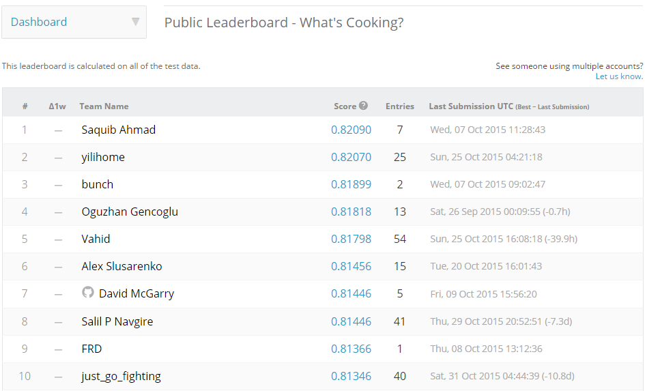
Final Results with Comparison
Official Test Set: 9,994 recipes composed of 4,479 ingredients
Final Classification Accuracy: 80.4%
Kaggle Ranking: 40 out of 881 (Top 4.5%)
[1] “Public Leaderboard,” What's Cooking? [Online]. Available at: https://www.kaggle.com/c/whats-cooking/leaderboard. [Accessed: Nov-2015].

Slide 48
Conclusions and Results

Slide 49
Conclusion – Importance of Using Libraries
To attack this problem, our team took two different approaches:
Develop code from scratch in Java and Python
Leverage public existing libraries (SciKit-Learn [1] and NLTK [2])
Benefits of Approach #1
More control over the algorithm
Reduced learning curve
Benefits of Approach #2
Substantially greater output once experienced with the tools.
Future Recommendation: Invest in learning how to use existing tools as the return on the investment is far higher long term.
[1] Scikit-learn: Machine Learning in Python, Pedregosa et al., JMLR 12, pp. 2825-2830, 2011.
[2] “nltk.stem package -- NLTK 3.0 documentation.” [Online]. Available at: http://www.nltk.org/api/nltk.stem.html. [Accessed: Nov-2015].

Slide 50
Potential Future Improvements

Slide 51
Enhanced NLP – Etymology and Context
Etymology – Study of the history and origin of words.
Downside of Current Implementation – We are performing almost no analysis of the ingredient words and phrases themselves.
Solution #1: Use etymological information of the ingredient word(s).
Solution #2: Use contextual information in the ingredient names.
Example: Part-of-Speech (POS) Tagging – Noun detection in ingredient names may be a superior preprocessor than simple word removal [1].
Benefits:
Etymology leverages additional data not included in the training set itself.
Enables classification analysis for “new” ingredients
[1] “Stanford Log-linear Part-Of-Speech Tagger,” The Stanford NLP (Natural Language Processing) Group. [Online]. Available at: http://nlp.stanford.edu/software/tagger.shtml. [Accessed: Nov-2015].

Slide 52
Recipe Ingredient Count Distribution
40 recipes had more than 30 ingredients with one recipe having 65 ingredients.

Slide 53
Utilizing Ingredient Count
One attribute of the dataset that we did not specifically consider in our analysis is the recipe’s number of ingredients.
It is possible that some cuisine types (e.g. Indian) have more ingredients than others (e.g. British).
Using ingredient count as an attribute may improve our classifier’s performance.

Slide 54
Interested in Our Work?
If you want to get a copy of the source code, see our results data, or are just bored, visit our GitHub repository:
https://github.com/ZaydH/CS256_Project.git

Slide 55
List of References
S. J. Russell and P. Norvig, Artificial intelligence: a modern approach, 3rd ed. Upper Saddle River, NJ: Prentice Hall, 2010.
“Introducing the Ultimate Cooking Tool,” Yummly. [Online]. Available at: http://www.yummly.com/how-it-works/. [Accessed: Oct-2015].
“What's Cooking?,”. [Online]. Available at: https://www.kaggle.com/c/whats-cooking. [Accessed: Oct-2015].
Baev, P. (1995). BIODIV: Program for calculating biological diversity parameters, similarity, niche overlap, and cluster analysis : Version 5.1(2nd ed.). Sofia: Pensoft.
“Overlap Coefficient,” Wikipedia. [Online]. Available at: https://en.wikipedia.org/wiki/overlap_coefficient. [Accessed: Oct-2015].
Improved Heterogeneous Distance Functions Journal of Artificial Intelligence Research, Vol. 6 (January 1997), pp. 1-34 by Randall Wilson, Tony R. Martinez
Scikit-learn: Machine Learning in Python, Pedregosa et al., JMLR 12, pp. 2825-2830, 2011.
“nltk.stem package -- NLTK 3.0 documentation.” [Online]. Available at: http://www.nltk.org/api/nltk.stem.html. [Accessed: Nov-2015].
“1.9. Naive Bayes,” scikit-learn 0.17 documentation. [Online]. Available at: http://scikit-learn.org/stable/modules/naive_bayes.html. [Accessed: Nov-2015].
“1.5. Stochastic Gradient Descent,” scikit-learn 0.17 documentation. [Online]. Available at: http://scikit-learn.org/stable/modules/sgd.html. [Accessed: Nov-2015].

Slide 56
List of References (Continued)
“1.11. Ensemble methods,” scikit-learn 0.17 documentation. [Online]. Available at: http://scikit-learn.org/stable/modules/ensemble.html. [Accessed: Nov-2015].
“sklearn.naive_bayes.MultinomialNB,” scikit-learn 0.17 documentation. [Online]. Available at: http://scikit-learn.org/stable/modules/generated/sklearn.naive_bayes.multinomialnb.html. [Accessed: Nov-2015].
“Jaccard index,” Wikipedia. [Online]. Available at: https://en.wikipedia.org/wiki/jaccard_index. [Accessed: Nov-2015].
D. Jurafsky and J. H. Martin, Speech and language processing: an introduction to natural language processing, computational linguistics, and speech recognition, 2nd ed. Upper Saddle River, N.J.: Pearson Prentice Hall, 2009.
“Public Leaderboard,” What's Cooking? [Online]. Available at: https://www.kaggle.com/c/whats-cooking/leaderboard. [Accessed: Nov-2015].
“Stanford Log-linear Part-Of-Speech Tagger,” The Stanford NLP (Natural Language Processing) Group. [Online]. Available at: http://nlp.stanford.edu/software/tagger.shtml. [Accessed: Nov-2015].
“Dropping common terms: stop words,” The Stanford NLP (Natural Language Processing) Group. [Online]. Available at: http://nlp.stanford.edu/ir-book/html/htmledition/dropping-common-terms-stop-words-1.html. [Accessed: Nov-2015].
“Stemming and lemmatization,” The Stanford NLP (Natural Language Processing) Group. [Online]. Available at: http://nlp.stanford.edu/ir-book/html/htmledition/stemming-and-lemmatization-1.html. [Accessed: Nov-2015].

Slide 57
List of References (Continued)
“Tokenization,” The Stanford NLP (Natural Language Processing) Group. [Online]. Available at: http://nlp.stanford.edu/ir-book/html/htmledition/tokenization-1.html. [Accessed: Nov-2015].
“Tf-idf weighting,” The Stanford NLP (Natural Language Processing) Group. [Online]. Available at: http://nlp.stanford.edu/ir-book/html/htmledition/tf-idf-weighting-1.html. [Accessed: Nov-2015].
Ting, K.M. & Witten, I.H. (1997). Stacked generalization: when does it work? Hamilton, New Zealand: University of Waikato, Department of Computer Science.
A. Ng, “CS229 Lecture Notes #1,” CS229 Machine Learning. [Online]. Available at: http://cs229.stanford.edu/notes/cs229-notes1.pdf. [Accessed: 2015].

Slide 58
Questions?
58

